Slide 1



BrisT1D Blood Glucose Prediction Competition
1st place solution
Sebastian Cuya
Notes:
Recommending picking out he most interesting and important parts from your documentation.

Slide 2
Agenda

Slide 3
Agenda
Background
Summary
Feature selection & engineering
Training methods
Important findings
Simple model

Slide 4
Background

Slide 5
Background
Education: Bachelor of Industrial Engineering (University of Lima)
Profession: AI & Data Senior Consultant
Experience: Participated in 2 previous competitions
Motivation: Apply learning from the MIT MicroMasters Program in Statistics and Data Science

Slide 6
Summary
Method: 1 LightGBM
Most important features: Blood glucose lags and differences (last 30 min)
Tools: Python, Jupyter Lab, VS Code
Estimated Times:
Preprocess: 3 min (expansion) + 2 min (transformation)
Train: 2 hour (tuning) + 1 min (fitting)
Predict: 1 second

Slide 7
Features Selection/
Engineering

Slide 8
Features Selection/Engineering
Feature Selection:
Statistical methods (ACF, PACF, CCF)
Feature Importance plots and SHAP values
Feature Engineering:
Blood Glucose lags (last 30 min)
All other features (last hour)
Time in minutes (trigonometric transformation)
Blood Glucose sampling gap (5 or 15 min)
Target encoding (mean, standard deviation, skewness, kurtosis)

Slide 9
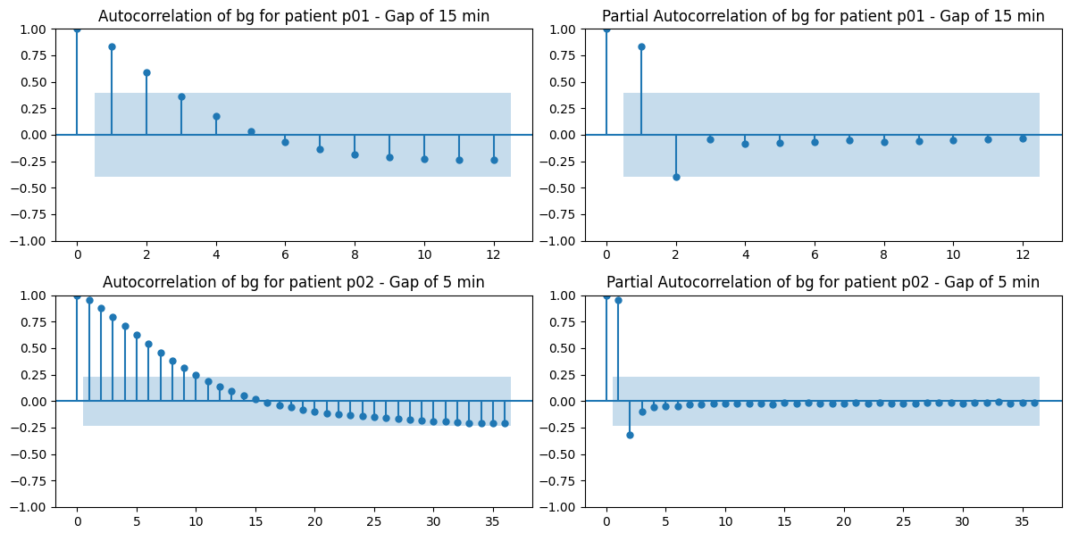
Features Selection/Engineering
ACF, PACF of blood glucose

Slide 10
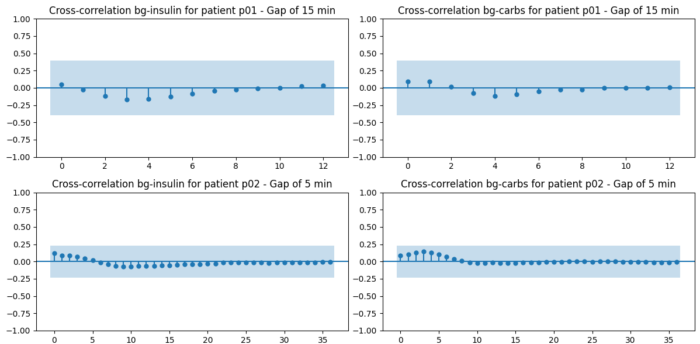
Features Selection/Engineering
CCF of blood glucose difference – Insuline, Carbs

Slide 11
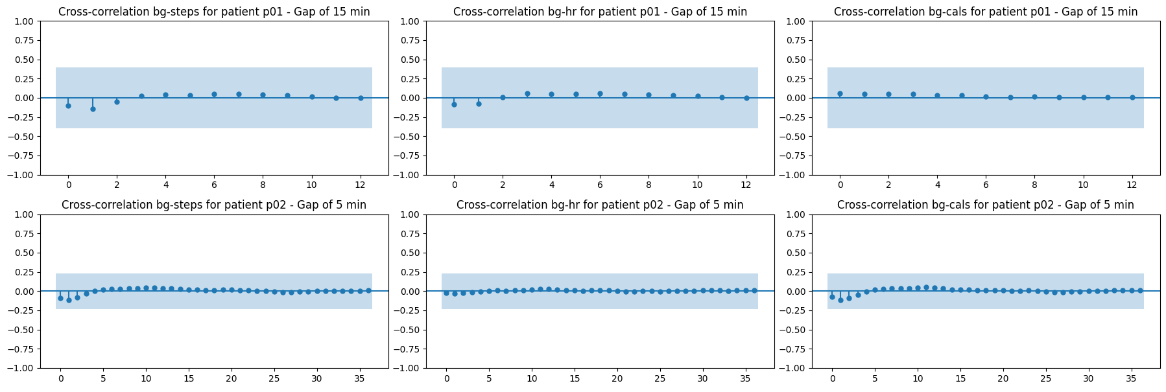
Features Selection/Engineering
CCF of blood glucose difference – Steps, Heart Rate, Calories

Slide 12
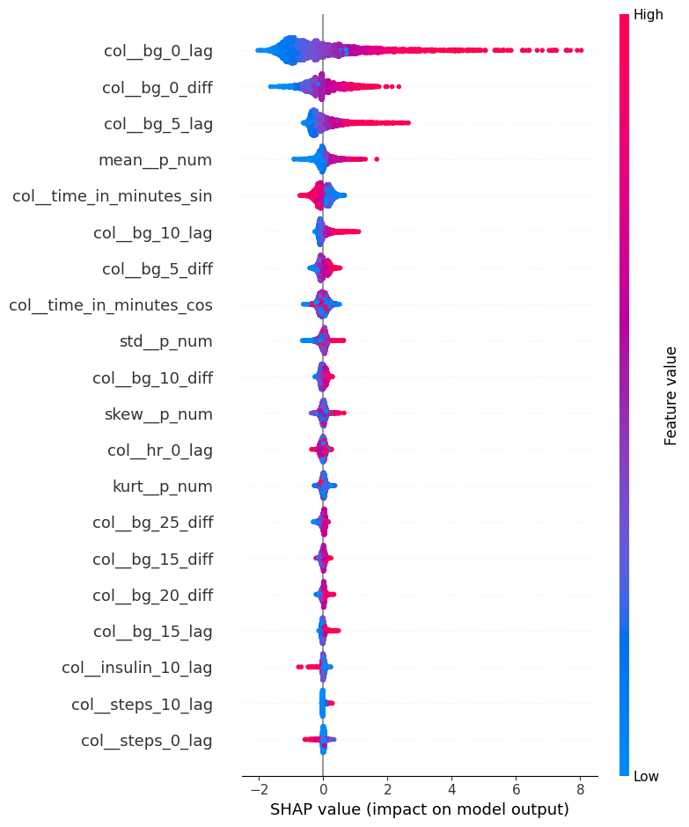
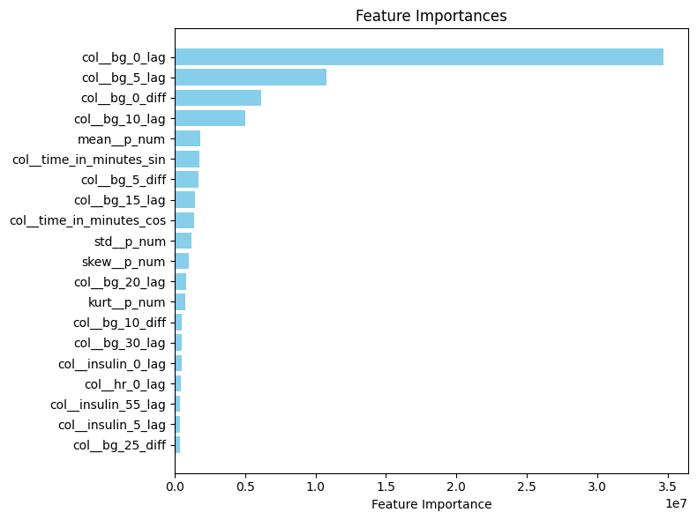
Features Selection/Engineering
Feature Importances – LightGBM and SHAP

Slide 13
Training Methods

Slide 14
Training Methods
Algorithm: 1 LightGBM
Cross Validation: Custom Expanding Window
Hyperparameter Tuning: Optuna
Kaggle Winner Presentation Template

Slide 15
Important and Interesting Findings

Slide 16
Important and Interesting Findings
More data could be obtained from the test data (wouldn’t be data leakage in itself)
The test data expansion allowed the use of a custom cross validation procedure
As for the data itself:
Insulin could provide predictive power up to 2 hours back, but 1 hour back got the majority of it
Carbohydrate intake provided predictive power up to 30 minutes back, but given it’s correlation with insulin, 1 hour of data was used
Activity-related features worked better together, specially “cals” and “activity”
Kaggle Winner Presentation Template

Slide 17
Important and Interesting Findings
Cross Validation Procedure

Slide 18
Simple Model

Slide 19
Simple Model
The model is already simple. # of features could be reduced (89 features)
Removing activity-related features is a first step
Removing insulin doses and carbs intake is a second step
Keeping just the last 15 minutes of blood glucose, the time-related features and a mean target encoder is the final step (simplified model – 10 features)

Slide 20
Solution Overview

Slide 21
Solution Overview
In summary:
My key insight would be that, after a considerable amount of testing, the best model was actually the one that the statistical analysis had initially suggested
The keys aspects that gave reliability and robustness to the process would be the combination of well-curated feature engineering and a reliable cross-validation procedure
This competition was really interesting and it helped me try out different methods, techniques, etc; with a real dataset.

Slide 22
Question and Answer

